Slide 1


Intro
Speaker:
Taras Aftanashchuk
Notes:
Introduce course and speacers

Slide 2
Why we need Typescript
Types
Better OOD
Minuses
compilation
Notes:
micrisoft team work

Slide 3

Types JS
Types TS
Boolean
Null
Undefined
Number
BigInt
String
Symbol (new in ECMAScript 6)
Object
any
void
enum
newer
tupple
Notes:
// Declare a tuple type
let x: [string, number];
typeof
=== vs ==

Slide 4
var
let
const

Slide 5

Function and function declaration
function test(params) {
return params }
let test = (params) => return parms
Notes:
tell about function
difference between declarations
pure functions
functional program
and scope
and closure

Slide 6
OOD
Encapsulation
Inheritance
Polymorphism
Inheritance vs Composition vs Aggregation
Notes:
tell about function
difference between declarations
pure functions
functional program
and scope
and closure

Slide 7

Notes:
tell about function
difference between declarations
pure functions
functional program
and scope
and closure

Slide 8

Notes:
tell about function
difference between declarations
pure functions
functional program
and scope
and closure

Slide 9
== vs ===
reference vs value type
Notes:
NaN === NaN
null == undefined
2 == “2”
2 === “2”

Slide 10
Class, Abstract class, Interface
export class User implements IUser {
private _age: number;
get age(): number {
return this._age;
}
get set(age: number) {
this._age = age’
}
constructor(ageL number) {
this._age = age;
}
getAge() {
return this._age
}
}
export interface IUser {
age?: number;
}
Notes:
OOD
constructor -> super

Slide 11
static
class Logger {
static log(user) {
return user;
}
}

Slide 12
Generic
export class List<T> {
getItem(): T {
return null;
}
}
new List<IUser>()
export interface IUser {
age: number;
}
Notes:
OOD

Slide 13
async/await
export class List<T> {
getItem(): Promise<T> {
return Promise.resolve(null);
}
}
const handleError = console.error,
handleItem = console.log;
list.getItem().then(handleItem, handleError);
async function getUser() {
try {
let item = await list.getItem();
} catch (e) {
console.error(e)
} finally {
console.log('finally')
}
}

Slide 14
destructuration
let user = {name: ‘Tom’’}
let userClone = {...user}
let users = [{name: ‘Tom’’}]
let usersClone = [...users]
Notes:
also Object.assign({})

Slide 15
Data structure

Slide 16
Object {}
static keys()
static hasOwnProperty()
prototype.
constructor
...
Notes:
OOD

Slide 17
Array []
splice
push
indexOf
findIndex
filter
some
every
sort
pop
shift
unshift
length

Slide 18
Map, WeakMap
set
get
delete
clear
has
keys
values
entries
size

Slide 19
Set, WeakSet
set
delete
clear
has
size

Slide 20
Debugging, console
log
error
warning
trace
table
timeStart
timeEnd

Slide 21
Functional programming
Pure functions
Immutability
referential transparency
First-class object
Higher-order functions
Notes:
pure functions + immutable data = referential transparency

Slide 22
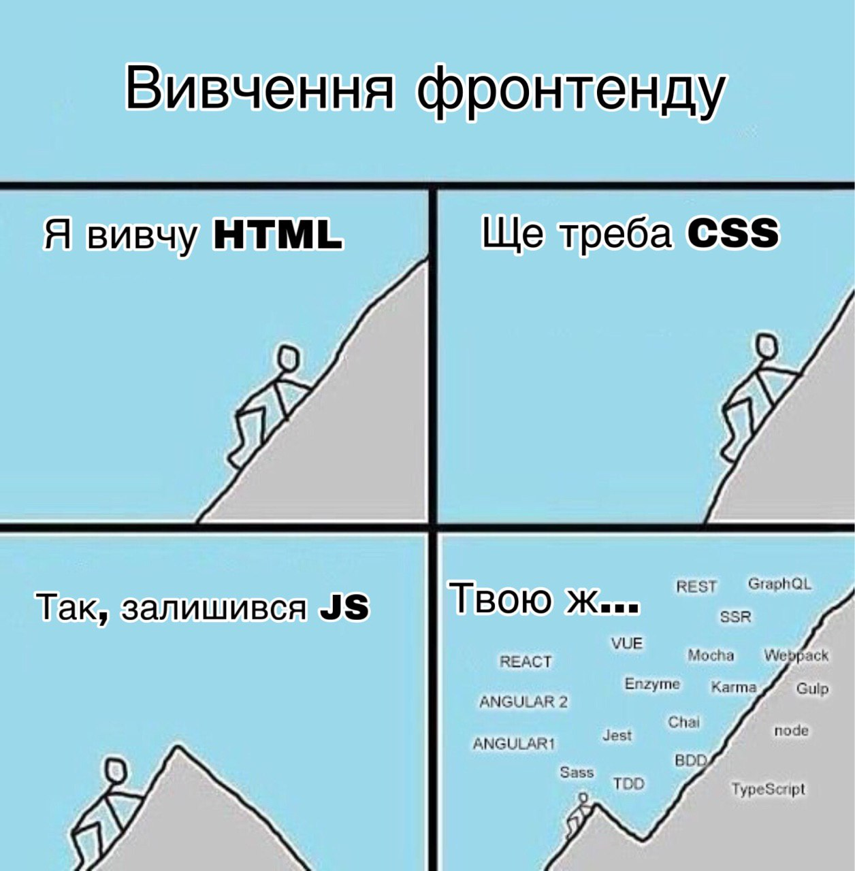
What next?
Notes:
mobile(nativescript, react native,ionic)
Electron
Web
Node js

Slide 23
Github project
https://github.com/Angular-RU/angular-universal-starter
Notes:
pure functions + immutable data = referential transparency

Slide 24

Thank you!

